Slide 1
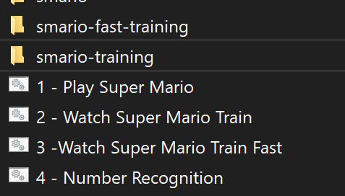
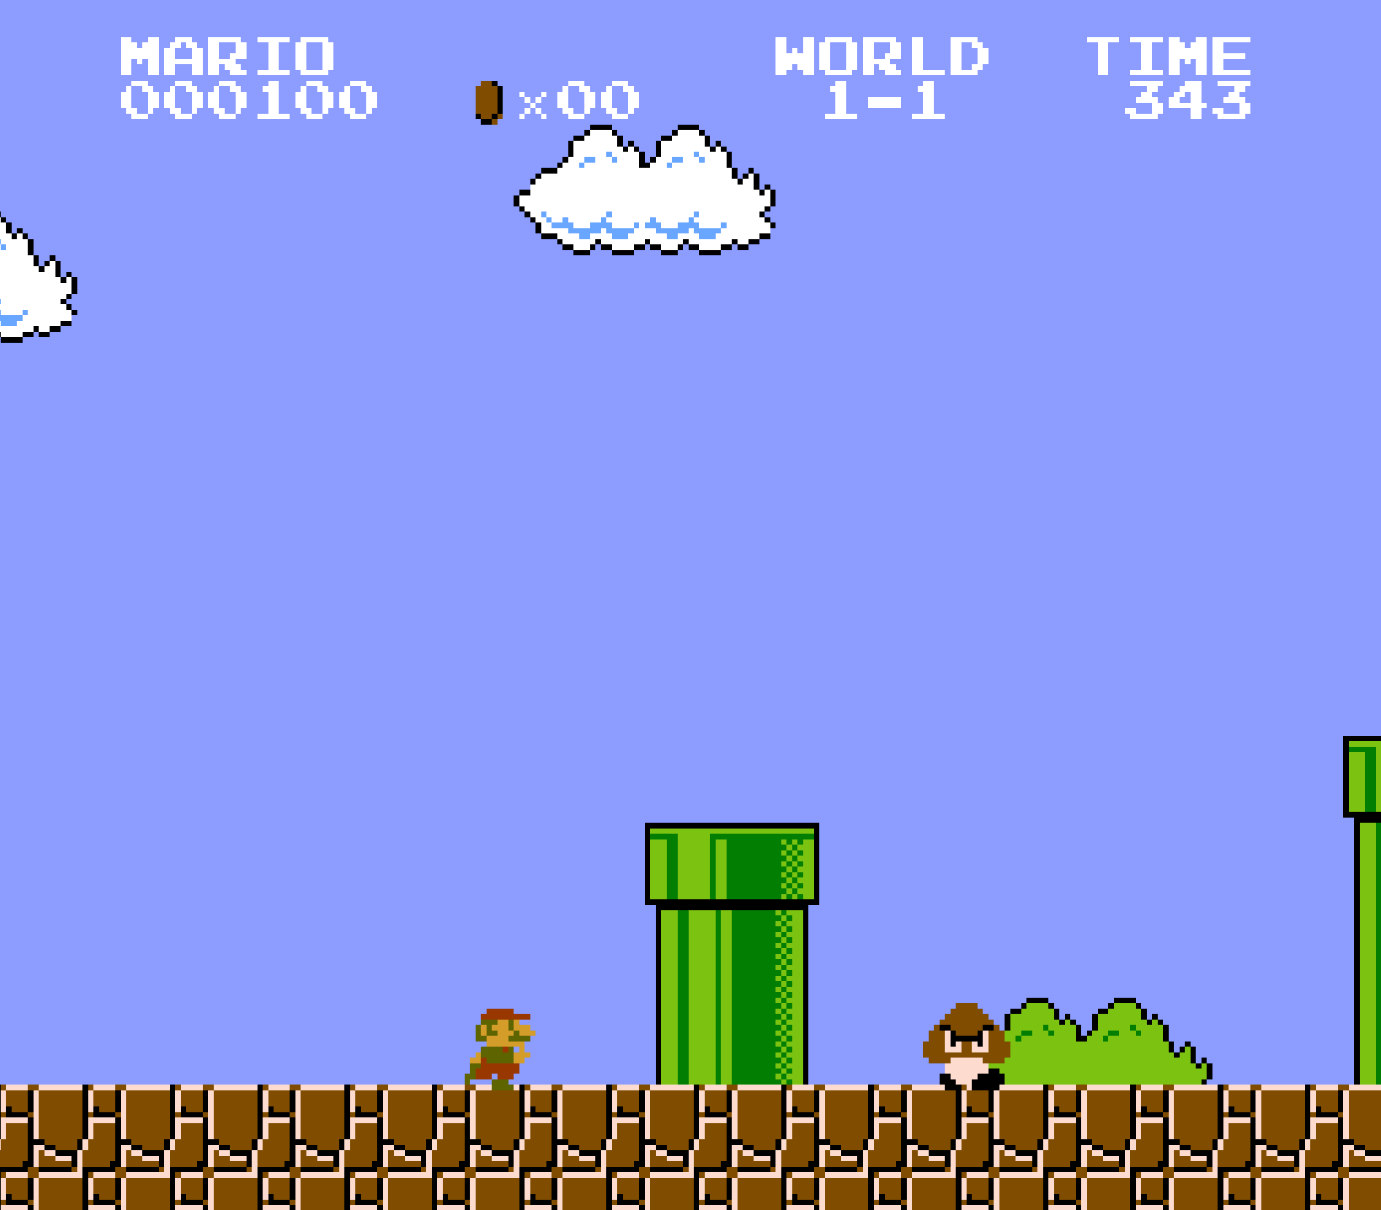
Let’s Train An “I”!
1
Open the “WOMAD AI” folder on the desktop
2
Start the game by double clicking “1 – Play Super Mario”
3
Hit the “Enter” key to start the game. Twice.
Use the arrow keys to move back and forth and the “X” key to jump!
Notes:
This is up on the screen showing when everyone shows up. Get them playing right away. Make sur they know to share with the team.
Timing: 0-5 minutes

Slide 2
As you learn how to play the game…
Trade so everyone gets a chance!
Watch yourself! Watch your partner!
You are you learning how to play:
How do you learn???
Notes:
Yell this over the noise of everyone getting settled and playing the game for the first time.
Time: 5-10 minutes.

Slide 3
What did you see?
Notes:
Use this for a discussion.
Time: 10-14 minutes

Slide 4
Repetition
Trying & Failing
Talking to Partners
Watching Partners
Notes:
Hopefully these will all have been touched on. So use this as confirmation bias.
Time: 14-16

Slide 5
Repetition
Trying & Failing
Notes:
Machine Learning and AI currently copies two things you were doing: Repetition and Trying & Failing.
Time: 16

Slide 6
Repetition
How Well Did We Do?
Evolution!
Trying & Failing
Notes:
And Combines with some way to figure out if it did well (high score!!!), and then someway to update the plan (evolution). Now all we have to do is keep trying and after each time see if we did better. If we did, we do more of whatever we changed. If we didn’t, then we change something else.
Time 17-18

Slide 7
A Plan to play the game
Play the Game
Update Our Plan
How Did We Do?
Notes:
Our little learning algorithm follows theis exact pattern!! We start with a plan to paly, play the game, see how far we got, and then mess with the plan to see if we can do better. But the messing is random, as you will see in a moment! Lets start it learning!!
Time: 19-20

Slide 8
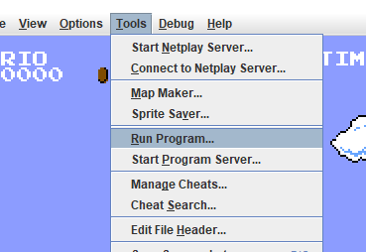
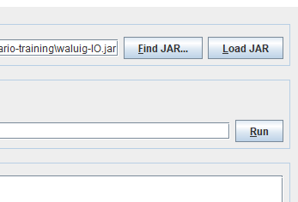
Lets Watch It Learn!
1
2
3
4
Notes:
Lets start it training. We will leave it training for a few minutes and come back and talk. And you’ll see how “dumb” the AI is at first. Do the steps here. If you get stuck when you step 3 raise your hands and I or someone else will be around to help you out. Again, start from your WOMAD AI folder on your desktop. And make the game full screen!
Pause for a minute to let everyone get up to speed. Once they are… Ask them what they see? Mostly the answer will be nothing – Mario is just standing there. Lets give him some time.
Time: 21-25

Slide 9
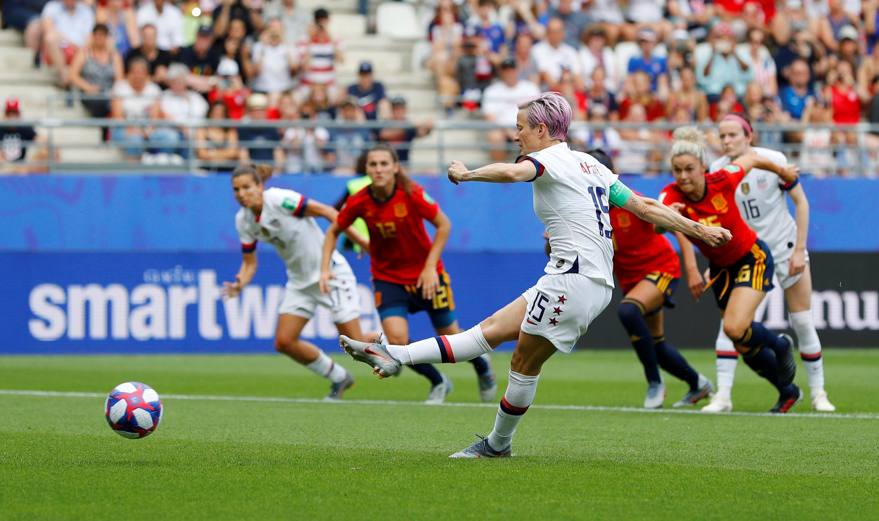
Megan Rapinoe
Notes:
Time: 26

Slide 10
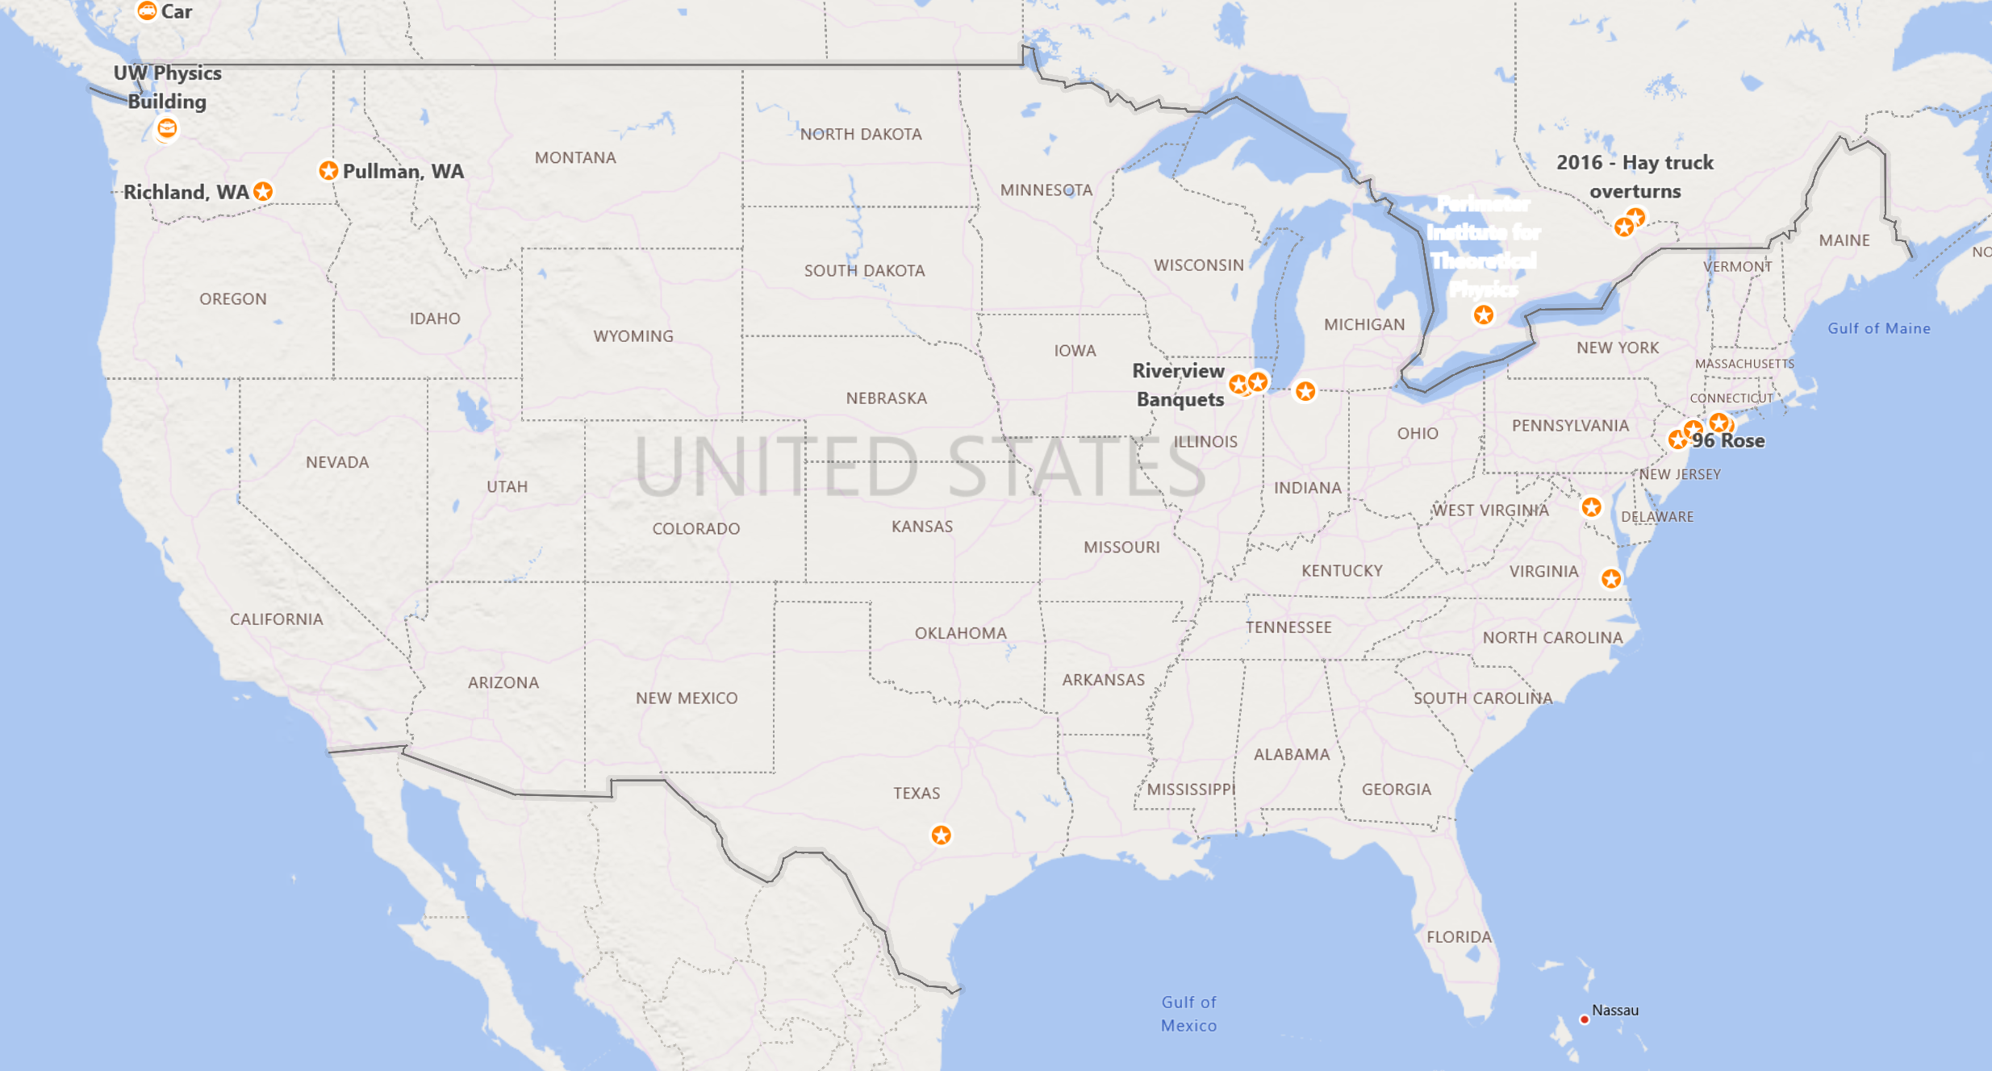
Notes:
Time 27

Slide 11
Notes:
Time: 28-31

Slide 12
Notes:
Time: 32

Slide 13
Notes:
Time: 33

Slide 14
Notes:
Time: 34

Slide 15
Notes:
Time:35

Slide 16
Notes:
Time: 36

Slide 17
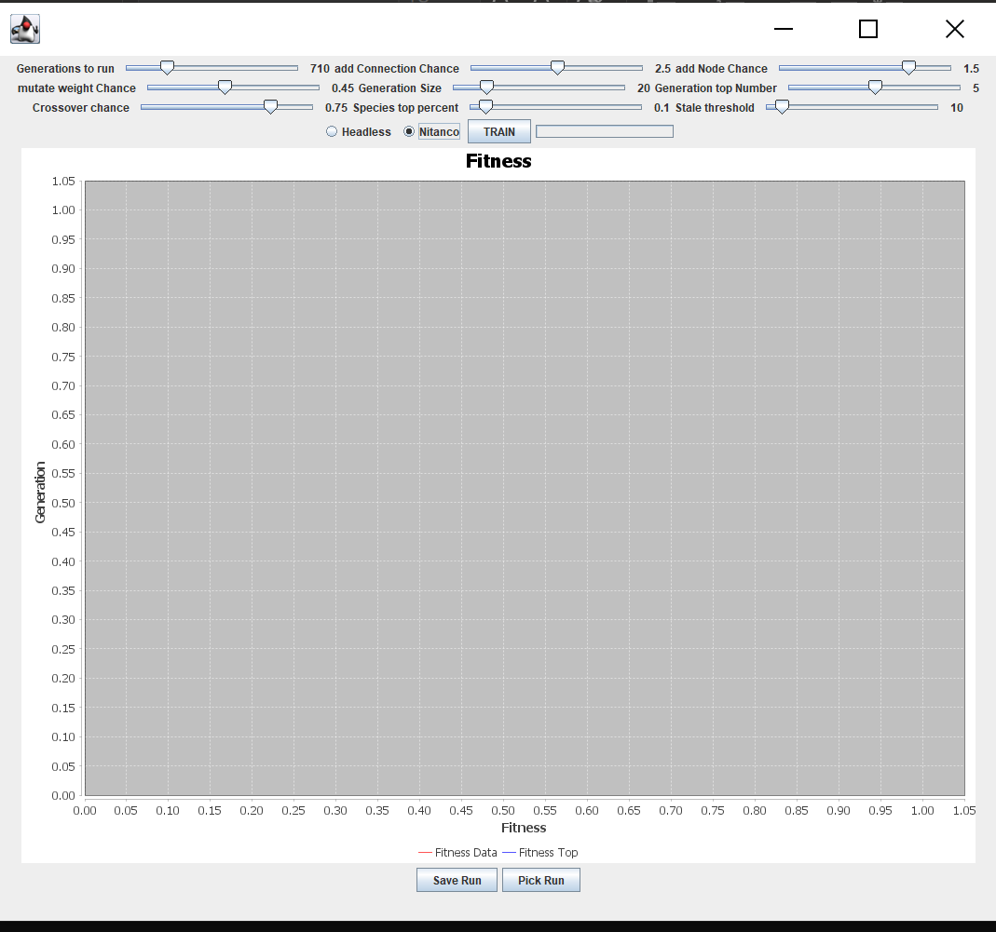
Lets Watch It Learn!
2
1
3
Set it to 700!
Notes:
Lets start it training. We will leave it training for a few minutes and come back and talk. And you’ll see how “dumb” the AI is at first. Do the steps here. If you get stuck when you step 3 raise your hands and I or someone else will be around to help you out. Again, start from your WOMAD AI folder on your desktop. And make the game full screen!
Pause for a minute to let everyone get up to speed. Once they are… Ask them what they see? Mostly the answer will be nothing – Mario is just standing there. Lets give him some time.
Time: 37-40

Slide 18
Famous Scientist Born in Shrewsbury, UK?

Slide 19
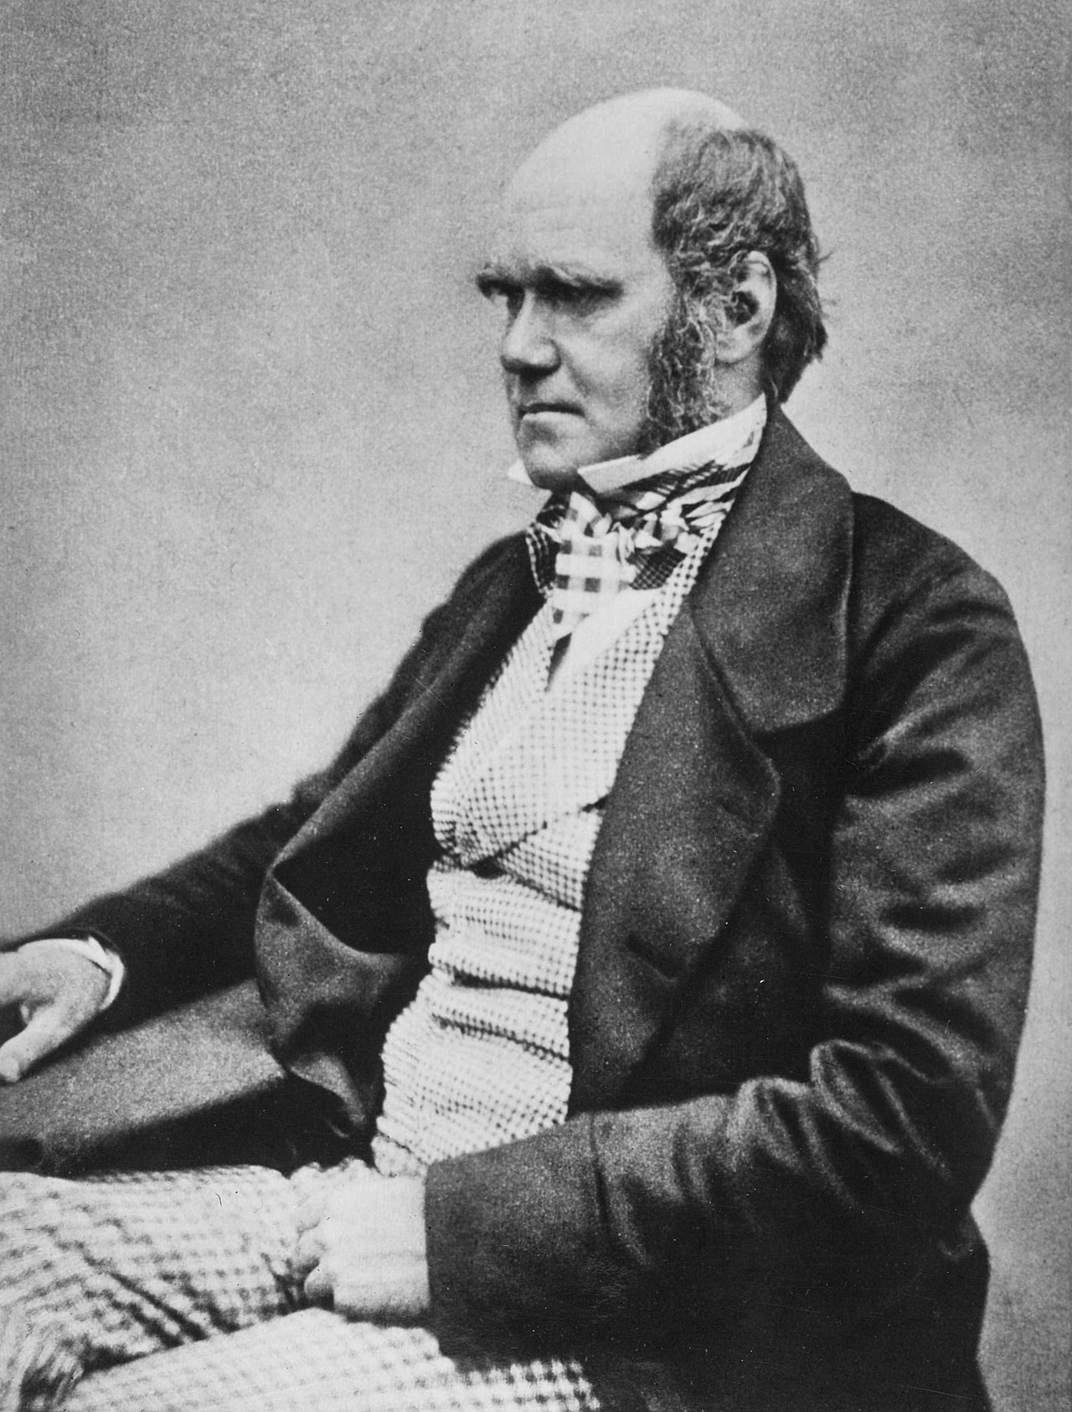

Slide 20
Genetic Algorithm

Slide 21
